Slide 1
State Veteran Home’s Bivalent Booster and COVID Risk

Slide 2
Study Period and Population
Exposure: bivalent booster
Outcome: covid infection
Patients in SVH facilities
Time period: 6 months after receiving bivalent booster
Potential Covariates: age, bivalent_type, race, gender, insurance, CT SVI
Potential time varying covariates: ???

Slide 3
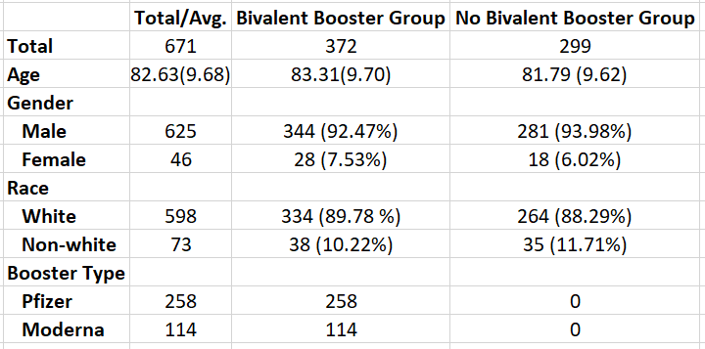
Population Counts

Slide 4
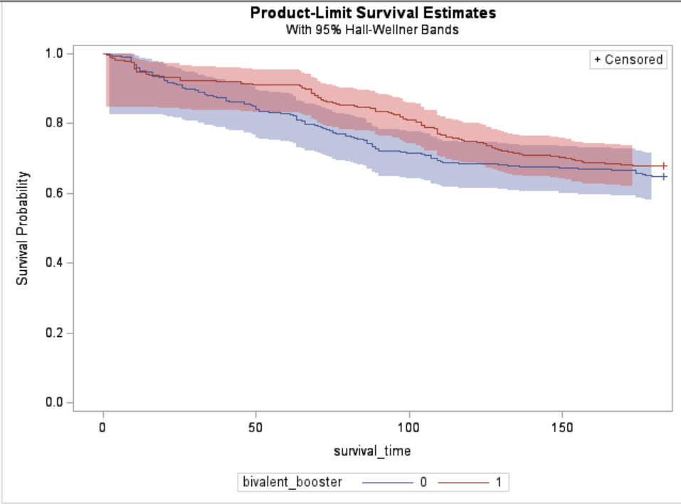
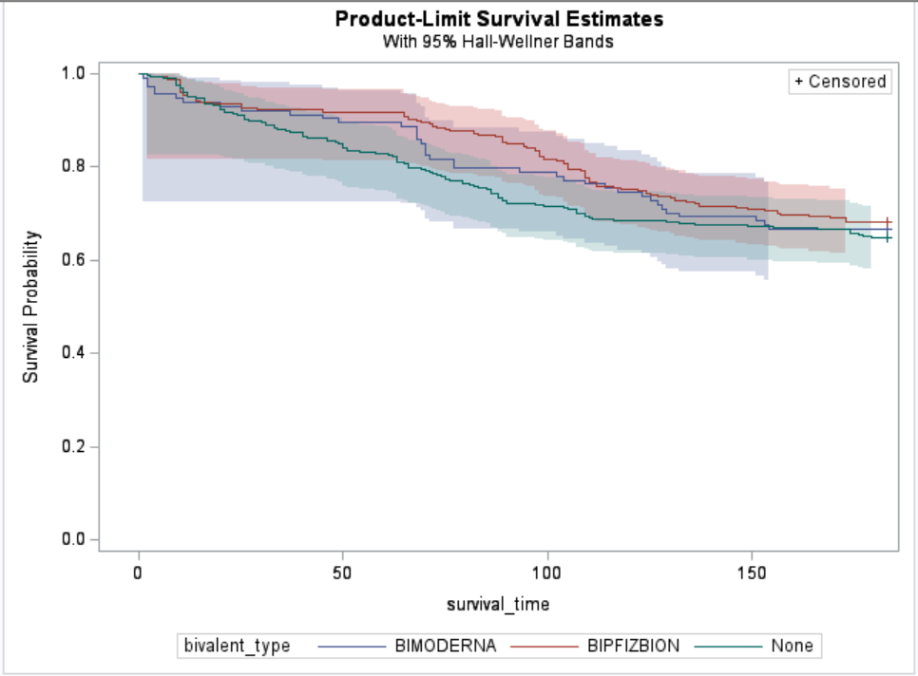
Survival Curves

Slide 5
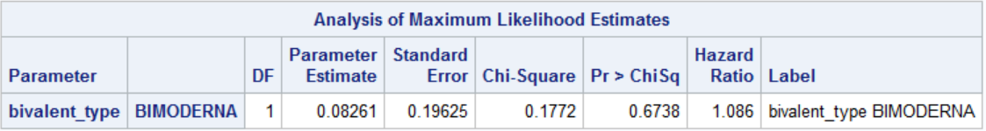
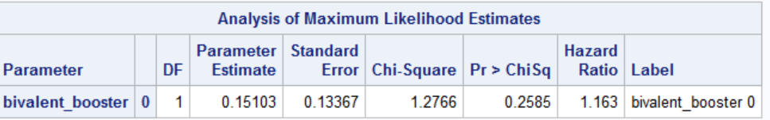


Crude Hazard Ratio

